Slide 1
4004CEM Computer Architecture & NETWORKS
CHAPTER 3:
DATA REPRESENTATION

Slide 2
LEARNING OUTCOMES
To understand the conversion and representing numbers, characters and symbols.

Slide 3
CONTENT
Representing numbers
Unsigned (no negative or positive sign in front of numbers e.g. 7,8,10)
Signed (has sign in front of numbers e.g. -7, +8, -10)
Floating point (e.g. 8.304)
Representing characters & symbols
ASCII
Unicode

Slide 4
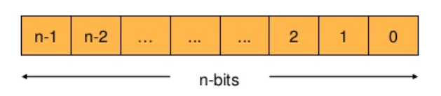
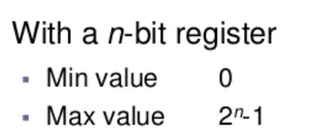
DATA REPRESENTATION in COMPUTERS
Data Representation refers to the form in which data is stored, processed, and transmitted.
Devices such as smartphones, iPods, and computers store data in digital formats that can be handled by electronic circuitry.
Data are stored in Registers.
Registers are limited in number & size. (e.g. 8 bits, 16 bits)

Slide 5
DATA REPRESENTATION
Qualitative
Represents quality or characteristics
Not proportional to a value
Quantitative
Quantifiable
Proportional to value a
Name, Address
No of students, marks for 120CT, CGPA

Slide 6
DATA REPRESENTATION
Data
Quantitative
Qualitative
Integers
Non-integers
Signed
Unsigned
Signed
Unsigned

Slide 7
Quantitative NUMBERS
Integers
Unsigned 20
Signed +20, -20
Non-integers
Floating point number -10.25, 3.33333…., 1/8 = 0.125

Slide 8
Signed Integers
We need a way to represent negative values
2 representations
Sign & Magnitude representation
Complement method

Slide 9
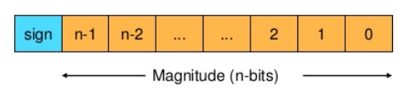
Sign & magnitude representation
n-bit unsigned magnitude & sign bit (S)
If S
0 – integer is a positive or zero
1 – integer is negative or zero
Range – (2^{n} -1 ) to + (2^{n}-1)

Slide 10
Example – sign & magnitude
If 8 bit register is used what are min & max numbers?
What are 0000 0000 and 1000 0000 in decimal?
Representation of zero is not unique

Slide 11
SIGNED BINARY NUMBERS
Signed Magnitude
MSB = sign bit
For an 8 bit word, -11₁₀ is 10001011
- Easy for human, but difficult to implement in hardware

Slide 12
sign & magnitude
Advantages
Sign reversal
Finding absolute value |a|
Flip sign bit
Disadvantage
Adding a negative of a number is not the same as subtraction
e.g. add 2 and -3
Needed different operations
Zero is not unique

Slide 13
SIGNED INTEGER REPRESENTATION
The conversions presented so far involved only positive numbers.
To represent negative values, computer systems allocate the high order bit to indicate the sign of a value.
The high order is the leftmost bit in a byte. It is also called the most significant bit.
The remaining bits contain the value of the number.

Slide 14
SIGNED INTEGER REPRESENTATION
There are three ways in which signed binary numbers may be expressed:
Signed magnitude
One’s complement
Two’s complement
In an 8 bit word, signed magnitude representation places the absolute value of the number in the 7 bits to the right of the sign bit.

Slide 15
SIGNED magnitude REPRESENTATION
For example, in a 8 bit signed magnitude,
POSITIVE 3 is : 0 0 0 0 0 0 1 1
NEGATIVE 3 is : 1 0 0 0 0 0 1 1
Computers perform arithmetic operations on signed magnitude numbers in much the same way as humans carry out pencil and paper arithmetic.
Humans often ignore the signs of the operands while performing a calculation, applying the appropriate sign after the calculation is complete.

Slide 16
SIGNED MAGNITUDE REPRESENTATION
Binary addition is as easy as it gets. You need to know only four rules:
0 + 0 = 0
0 + 1 = 1
1 + 0 = 1
1 + 1 = 1 0
The simplicity of this system makes it possible for digital circuits to carry out arithmetic operations.

Slide 17
SIGNED MAGNITUDE REPRESENTATION
Example 1: BOTH Positive (+ve)
Using signed magnitude binary arithmetic, find the sum of 75 and 46.
0 1 0 0 1 0 1 1
0 + 0 1 0 1 1 1 0
0 1 1 1 1 0 0 1
First, convert 75 and 46 to binary and arrange as a sum, but separate the (positive) sign bits from the magnitude bits.

Slide 18
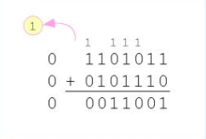
SIGNED MAGNITUDE REPRESENTATION
Example 2: with overflow
Using signed magnitude binary arithmetic, find the sum of 107 and 46.
We see that the carry from the seventh bit overflows and is discarded, giving us the erroneous result: 107 + 45 = 25.

Slide 19
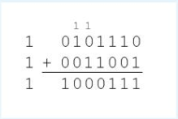
SIGNED MAGNITUDE REPRESENTATION
The signs in signed magnitude representation work just like signs in pencil and paper arithmetic.
Example 3 : BOTH NEGATIVE
Using signed magnitude binary arithmetic, find the sum of -46 and -25.

Slide 20
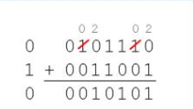
SIGNED MAGNITUDE REPRESENTATION
Mixed sign addition (or subtraction) is done the same way
Example 4: Different sign
Using signed magnitude binary arithmetic, find the sum of 46 and -25.
The sign of the result gets the sign of the number that is larger.
Note the ‘borrows’ from the second and sixth bits.

Slide 21
SIGNED MAGNITUDE REPRESENTATION
Signed magnitude representation is easy for people to understand, but it requires complicated computer hardware.
Another disadvantage of signed magnitude is that it allows two different representations for zero: positive zero and negative zero.
For these reason (among others) computers systems employ complement systems for numeric value representation.

Slide 22
One’s complement representation
For example, in 8 bit one’s complement,
POSITIVE 3 is : 0 0 0 0 0 0 1 1
NEGATIVE 3 is : 1 1 1 1 1 1 0 0
In one’s complement, as with signed magnitude, negative values are indicated by a 1 in the high order bit
Complement systems are useful because they eliminate the need for special circuitry for subtraction.
The difference of two values is found by adding the minuend to the complement of the subtrahend.

Slide 23
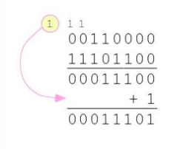
One’s complement representation
With one’s complement addition, the carry bit is “carried around” and added to the sum.
Example : Using one’s complement binary arithmetic, find the sum of 48 and -19
We note that 19 in one’s complement is 00010011,
so -19 in one’s complement is 11101100

Slide 26
One’s complement representation
Although the ‘end carry around’ adds some complexity, one’s complement is simpler to implement than signed magnitude.
But it still has disadvantage of having two different representations for zero: positive zero and negative zero.
Two’s complement solves this problem.
Two’s complement is the radix complement of the binary numbering system.

Slide 27
Two’s complement representation
To express a value in two’s complement:
If the number is positive, just convert it to binary and you are done
If the number is negative, find the one’s complement of the number and then add 1.
Example:
In 8 – bit one’s complement, positive 3 is : 0 0 0 0 0 0 1 1
Negative 3 is one’s complement is : 1 1 1 1 1 1 0 0
Adding 1 gives us -3 in two’s complement form 1 1 1 1 1 1 0 1.

Slide 29
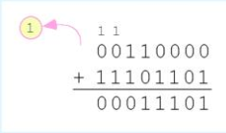
One’s complement representation
With two’s complement arithmetic, all we do is add our two binary numbers. Just discard any carries emitting from the high order bit.
Example:
Using one’s complement binary arithmetic, find the sum of 48 and -19.
We note that 19 in one’s complement is : 0 0 0 1 0 0 1 1
So -19 in one’s complement is : 1 1 1 0 1 1 0 0
And -19 in two’s complement is : 1 1 1 0 1 1 0 1

Slide 31
OVERFLOW
When we use any finite number of bits to represent a number, we always run the risk of the result of our calculations becoming too the result of our calculations becoming too large to be stored in the computer.
While we cannot always prevent overflow, we can always detect overflow.
In complement arithmetic, an overflow condition is easy to detect.

Slide 33
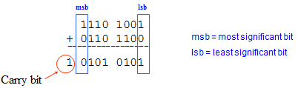
Carry
When the result of the calculation produces an extra bit out from the most significant bit position, we call this bit as carry bit.

Slide 34
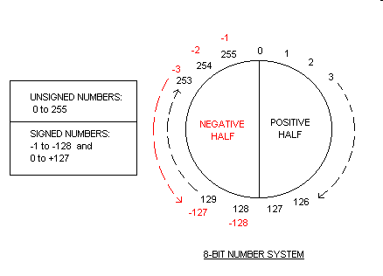
Signed & Unsigned Numbers
An 8 bit number system can be used to create 256 combinations (from 0 to 255),
and the first 128 combinations (0 to 127) represent positive numbers
and next 128 combinations (128 to 255) represent negative numbers.

Slide 35
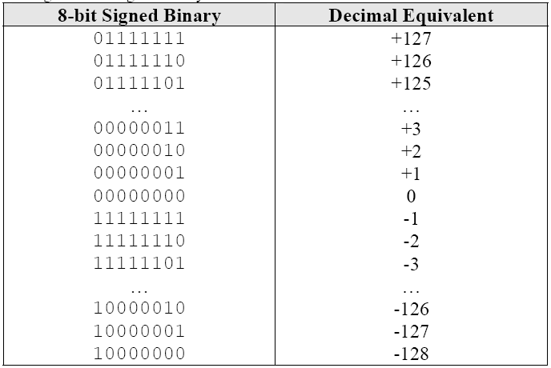
Signed Binary Numbers
The first bit, the MSB, is used as the sign bit.
Take for example, 8-bit signed binary:

Slide 36
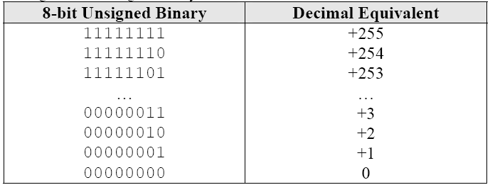
Unsigned Binary Numbers
All the bits are used as numbers.
Take for example, the 8-bit unsigned binary:

Slide 37
Span & Range
Note that both 8-bit signed and 8-bit unsigned can represent a total of 256 numbers.
So, they are identical in but different ine:
8-bit signed binary ranges from -128 to +127
8-bit unsigned binary ranges from 0 to 255

Slide 39
Summary

Slide 40
How to calculate 1's complement for a binary number?
The 1's complement can be easily calculated by inverting the 0s & 1s of a given binary number.
Example:
11011000 -> 00100111

Slide 41
How to calculate 2's complement for a binary number?
1. Find the one's complement by inverting 0s & 1s of a given binary number. 2. Add 1 to the one's complement provides the two's complement.
Example:
00111010
10000101 + 1 = 10000110

Slide 42
How to calculate 1's complement for a decimal number?
Here is a quick summary of how to find the 1's complement representation of any decimal number x.
If x is positive, simply convert x to binary.
If x is negative, write the positive value of x in binary
Reverse each bit.
Example:
a) -34
34 = 32 + 2 = 00100010
-34 = 11011101
b) +103
+103 = 64 + 32 + 4 + 2 + 1 = 01100111

Slide 43
How to calculate 2's complement for a decimal number?
Here is a quick summary of how to find the 2's complement representation of any decimal number x. Notice the first three steps are the same as 1's complement.
If x is positive, simply convert x to binary.
If x is negative, write the positive value of x in binary
Reverse each bit.
Add 1 to the complemented number.
a) +101
+101 = 64 + 32 + 4 + 1 = 01100101
b) -109
+109 = 64 + 32 + 8 + 4 + 1 = 01101101
-109 = 10010010 + 1 = 10010011

Slide 44
ASCII Code
American Standard Code for Information Interchange (ASCII), is a coding standard that can be used for interchanging information, if the information is expressed by English words.
A Standard ASCII has values from 0 to 127 (7 bits). Represented by 7-bit binary code.
Extended ASCII uses 0 to 255 (8 bits).

Slide 45
ASCII Code
ASCII reserves the first 32 codes (numbers 0–31 decimal) for control characters (NULL, Line Feed)
Code 32, the "space" character.
Code 127, the DELETE control
Codes 33 to 126, known as the printable characters, represent letters, digits, punctuation marks, and a few miscellaneous symbols.

Slide 46
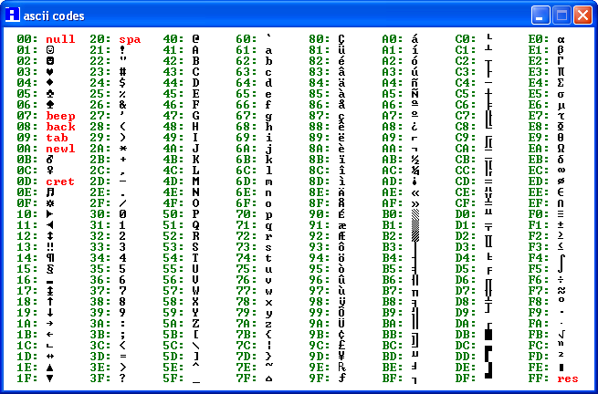
ASCII Code

